Slide 1
Dynamic Scalable View Maintenance
Jan Adler, Martin Jergler, Hans-Arno Jacobsen
Application & Middleware Systems Research Group
Prof. Hans-Arno Jacobsen

Slide 2


Client
Client
Client
Client
Query
put(Bastable{rec})
put(Bastable{rec})
$$Viewtable=$$
$$SELECT Sum\left(c2\right) \\ FROM Basetable \\ GROUP BY c1 \\ WHERE c2<10$$
del(Bastable{rec})
del(Basetable{rec})
API
KV-Store
Node 1
Node 2
Node 3
Node N
Basetable
Viewtable
VMS
hash ring
hash ring
hash ring
hash ring
View manager
View manager
View manager
View manager
View manager
View manager
View manager
View manager
View manager

Slide 3
ISDS seminar
Participants organized in teams of two students
Each team introduces a large scale architecture either Open Source or major internet companies
HDFS, Apache‘s HBase, Apache‘s Spark
Google‘s file system, Google‘s Bigtable
Facebook‘s Cassandra, Sc

Slide 4
ISDS seminar
Each team provides
A 10 minute video
Is accessible for couse as learning video
Best video is voted in the end
A 30 min presentation during course, including
a set of presentation slides
a session using online
A 5 pages written report
Resembeling a conference paper
ACM template, double column

Slide 5
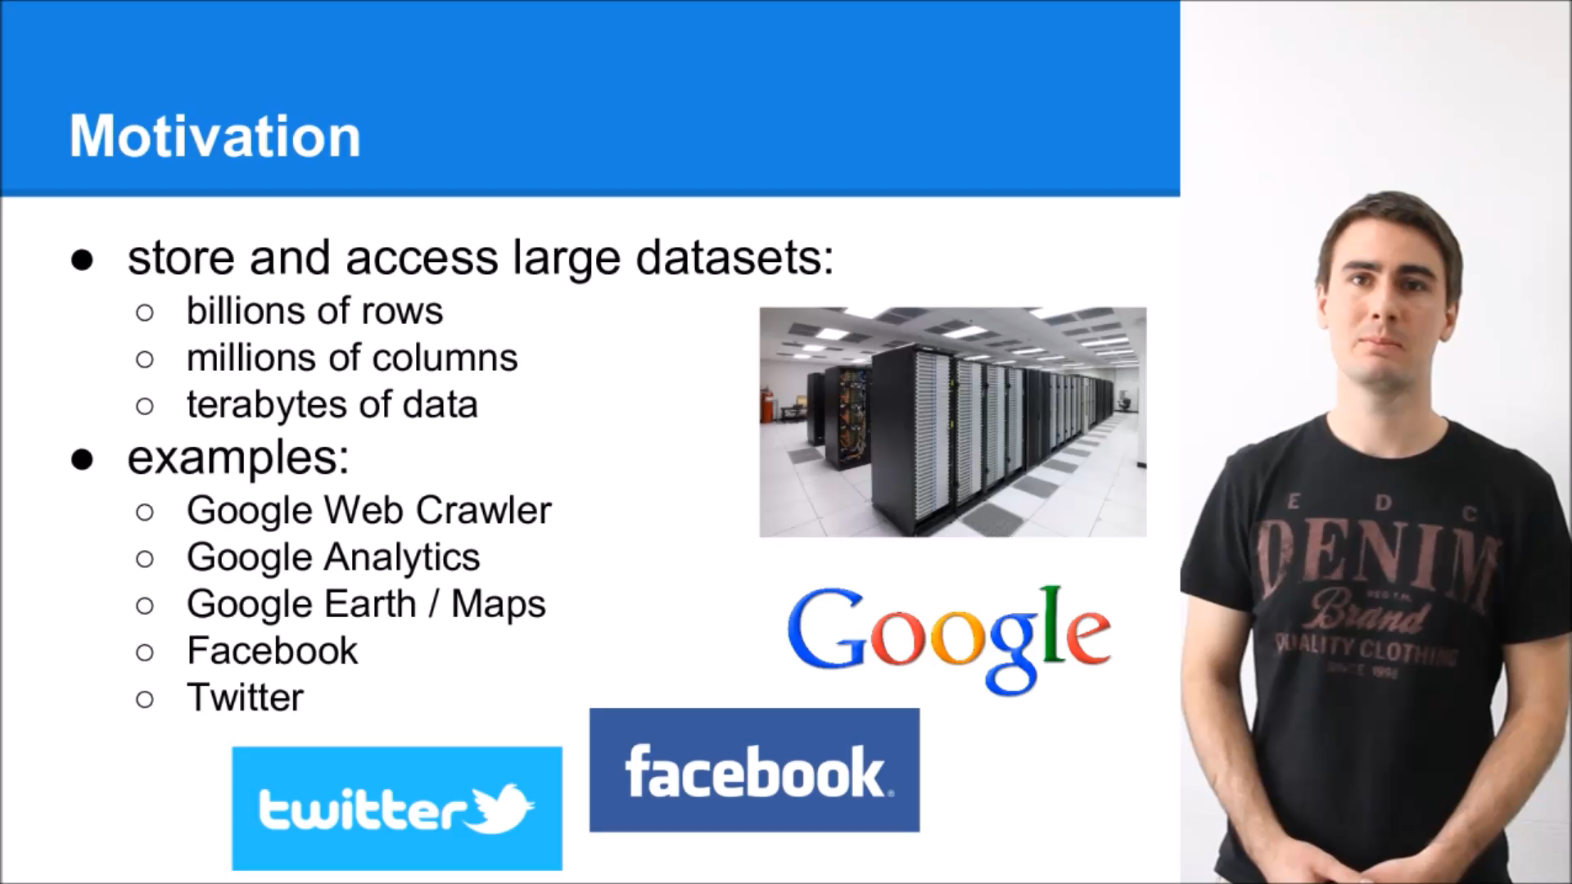
Example (1)

Slide 6
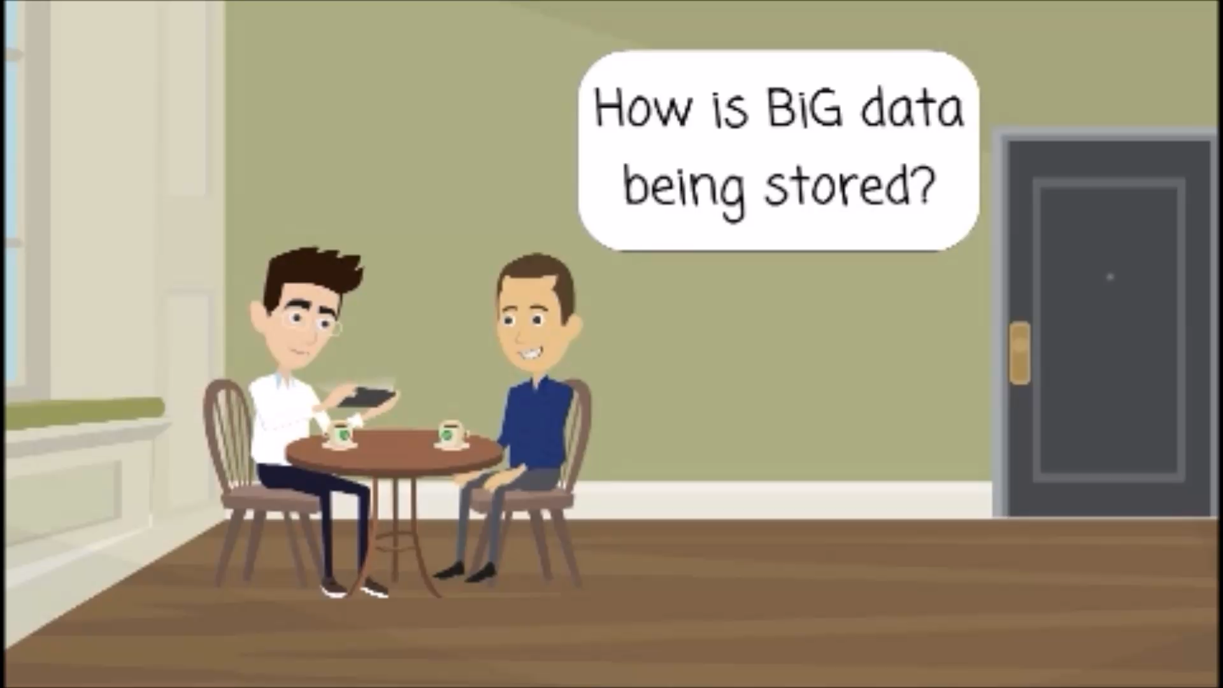
Example (2)

Slide 7
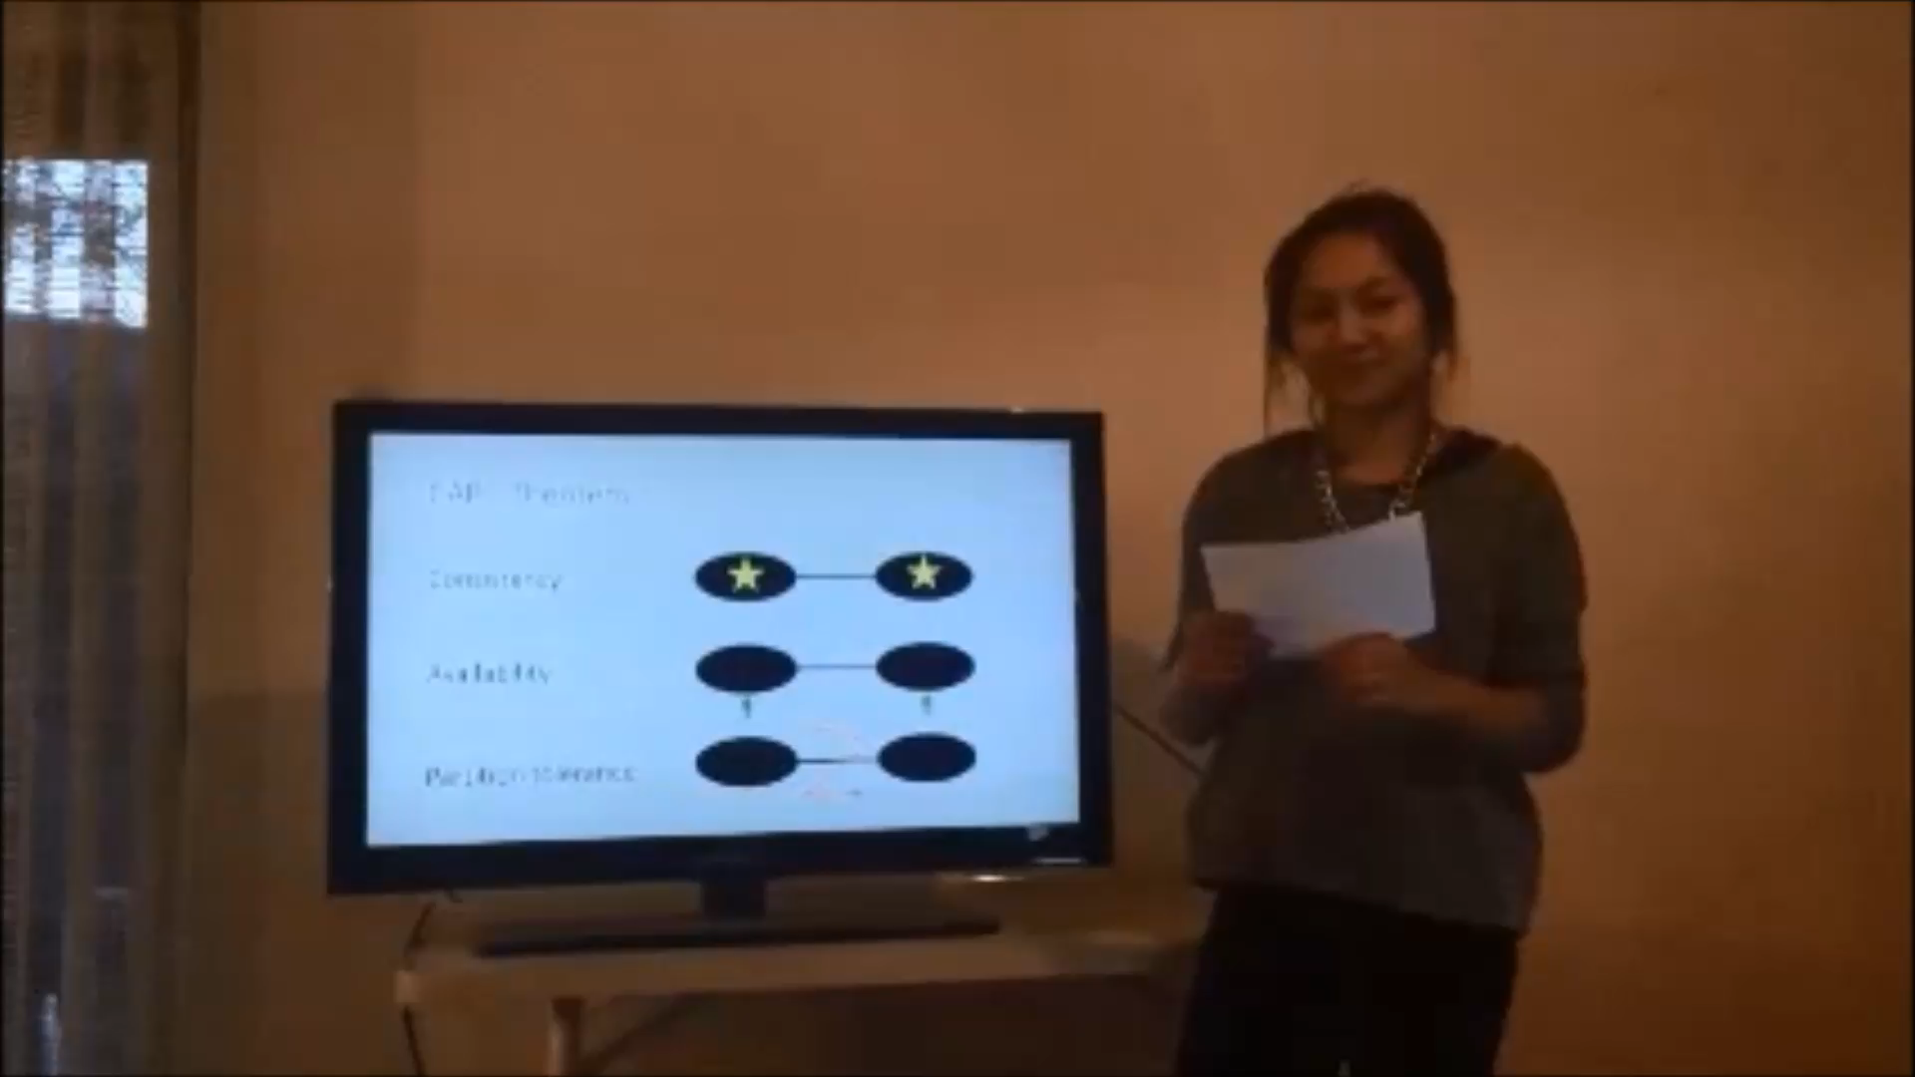
Example (3)

